Slide 1
Dynamic Model Attributes
Module - 17

Slide 2
Contents
Dynamic Attribute Overview
Good Uses for Dynamic Attributes
Pitfalls to avoid when using Dynamic Attributes
Examples of Dynamic Attributes
Implementing Dynamic Attributes

Slide 3
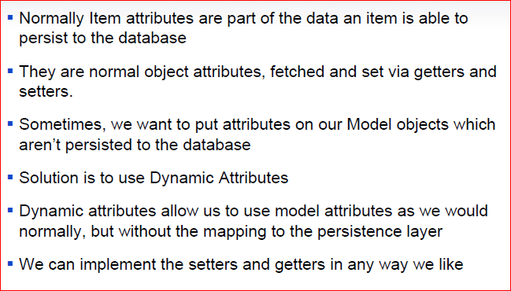
Dynamic Model Attributes Overview

Slide 4
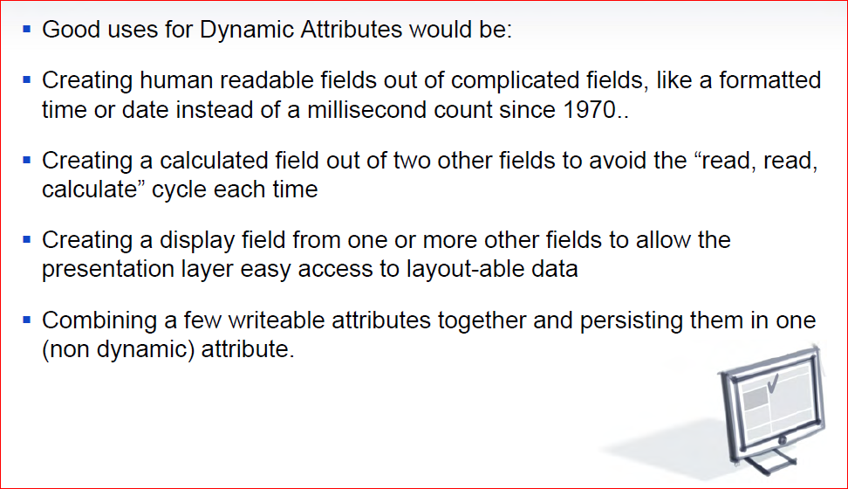
Good Uses for Dynamic Attributes

Slide 5
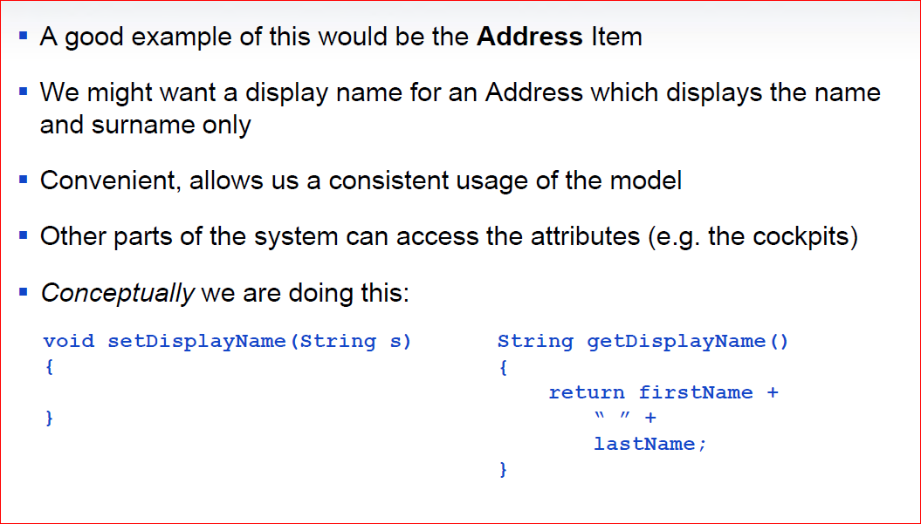
Good Uses for Dynamic Attributes

Slide 6
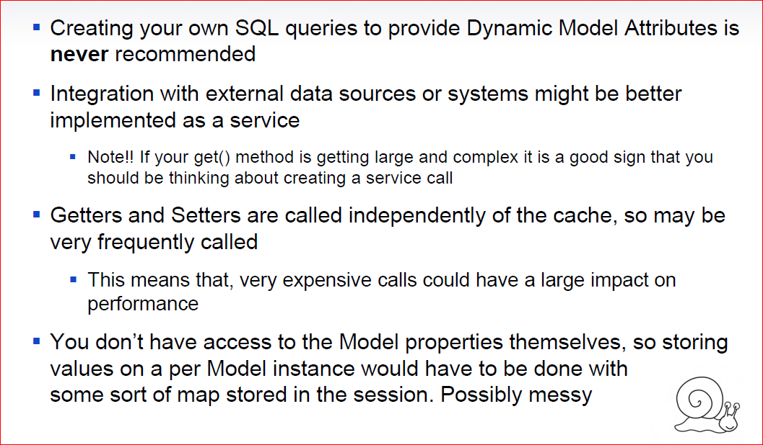
Pitfalls to avoid when using Dynamic Attributes

Slide 7
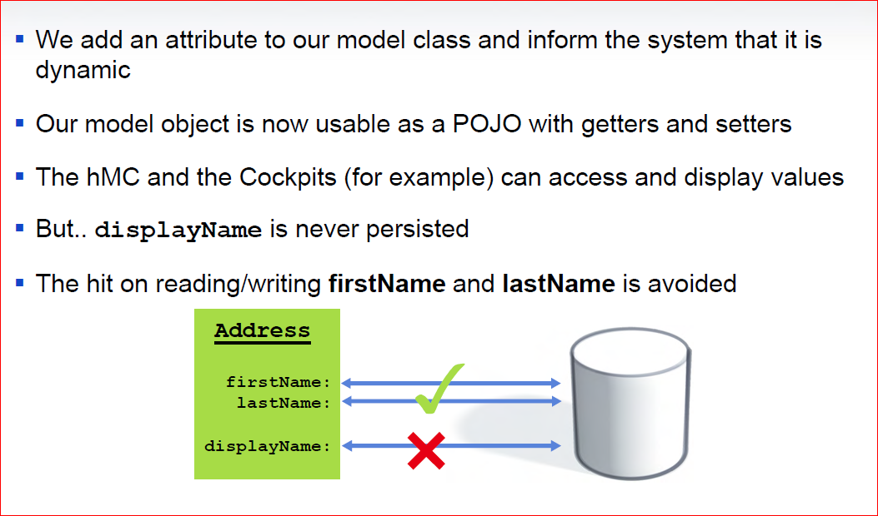
Examples of Dynamic Attributes

Slide 8
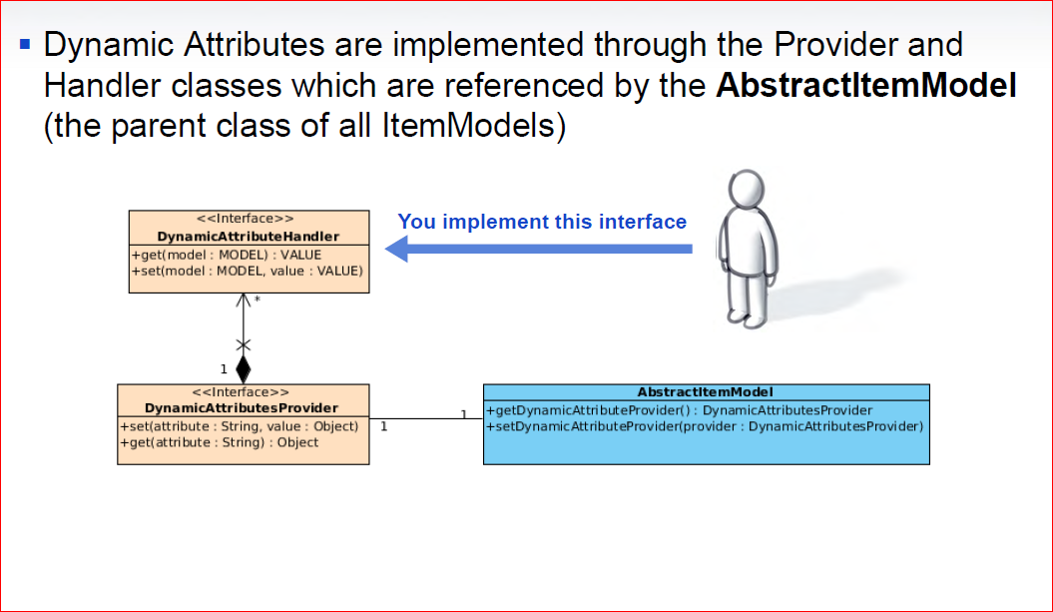
Implementing Dynamic Attributes

Slide 9
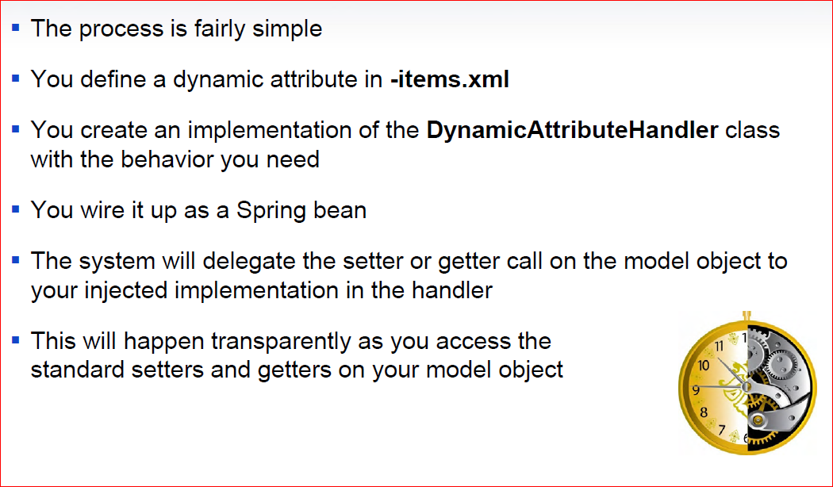
Implementing Dynamic Attributes

Slide 10
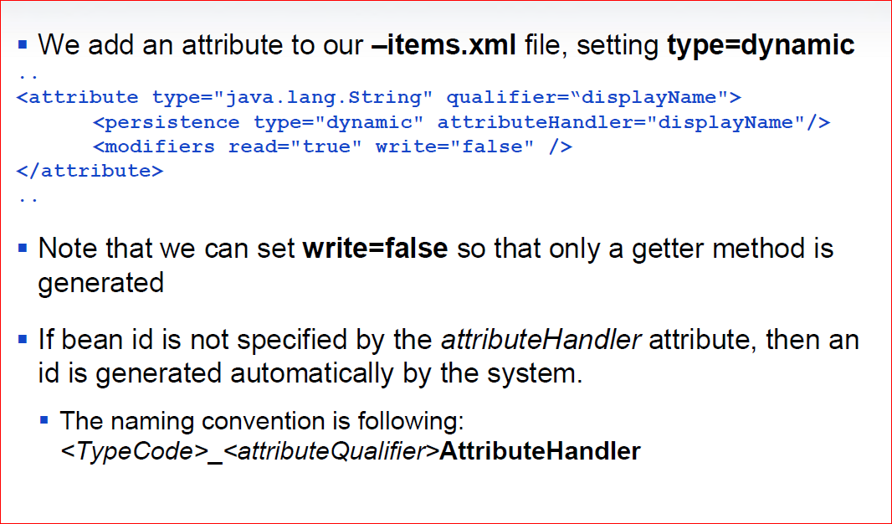
Implementing Dynamic Attributes

Slide 11
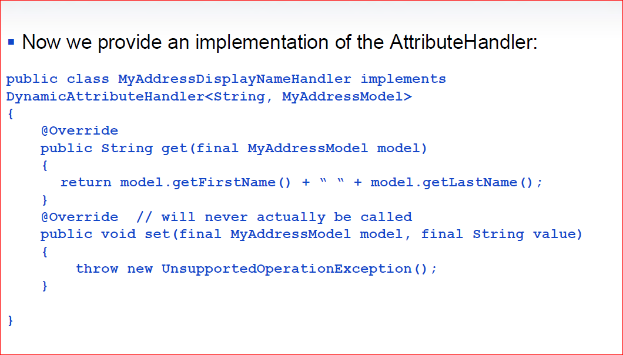
Implementing Dynamic Attributes

Slide 12
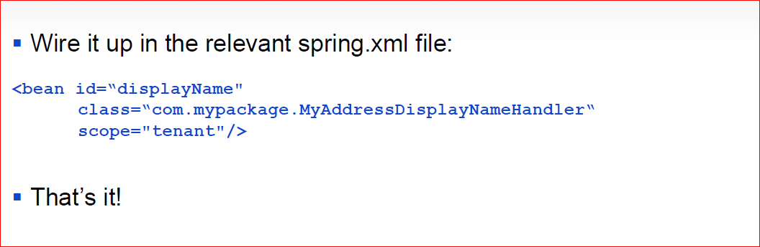
Implementing Dynamic Attributes

